Slide 1
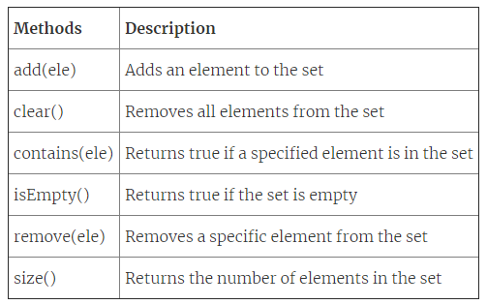
Sets & Maps
Sets
A set is a collection of unordered elements without any duplicates.
Properties:
Unlike lists and stacks, the elements present in a set do not follow any particular order. They are randomly present in the set.
The elements are not repeated in a given set.
Usage: A set can be used to determine if a node is a neighbour of another node i.e. if you store all of node A’s neighbours as a set, you can use the contains() method to quickly find out if a node named X is a neighbour of node A.

Slide 2
Sets & Maps
Maps
Maps represent a collection type that provides connection or mapping between the elements of a source set (domain) and a target set (range). A Map cannot contain duplicate keys and each key can map to at most one value.(Keys are unique but values can be repeated)
Methods in Map Interface:
public Object put(Object key, Object value): This method is used to insert an entry in this map.
public void putAll(Map map): This method is used to insert the specified map in this map.
public Object remove(Object key): This method is used to delete an entry for the specified key.
public Object get(Object key):This method is used to return the value for the specified key.
public boolean containsKey(Object key): This method is used to search the specified key from this map.
public Set keySet(): This method is used to return the Set view containing all the keys.
public Set entrySet(): This method is used to return the Set view containing all the keys and values.

Slide 3
Trees
By: Sehajpreet Singh

Slide 4
Introduction
Data Structures: Ways to store and organize data.
For different type of data we use different data structures. The choice of data structures may depend on the following factors:
What needs to be stored?
Cost of Operations
Memory Usage
Ease of Implementation(may not be a Primary Factor)
What would be the best Data Structure to Organize Hierarchical data? For example organizational hierarchy of some company?

Slide 5
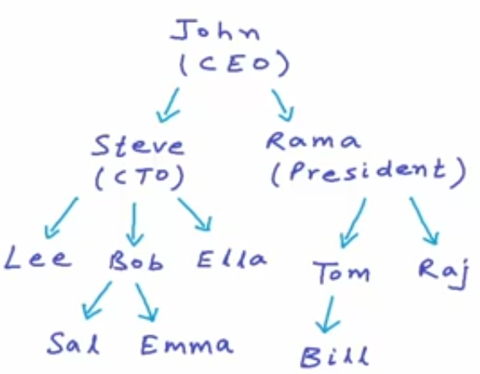

Trees
Tree is a non-linear data structure.
Each node may contain some data and link to other nodes.

Slide 6
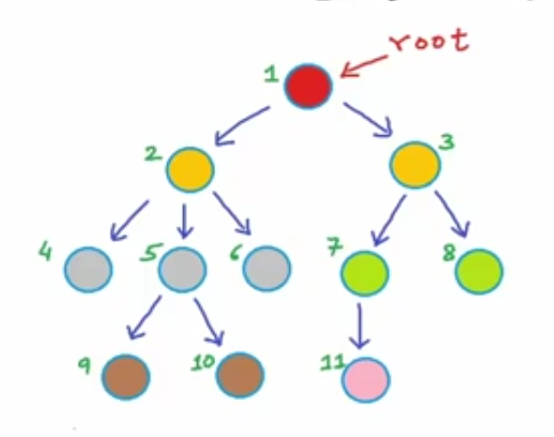
Some Terminologies:
Root
Children
Parent
Sibling
Leaf
Ancestor

Slide 7
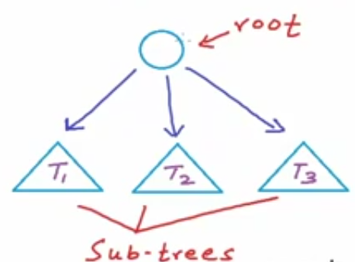
Tree is a Recursive Data Structure

Slide 8
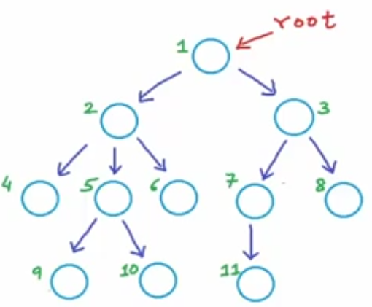
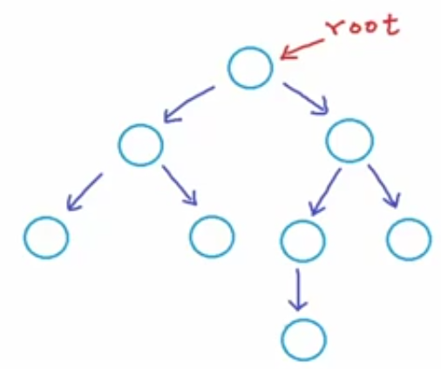
Binary Tree
A tree in which each node can have at max 2 children.

Slide 9
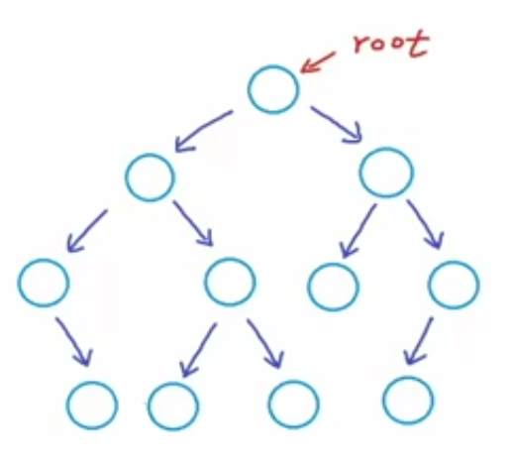
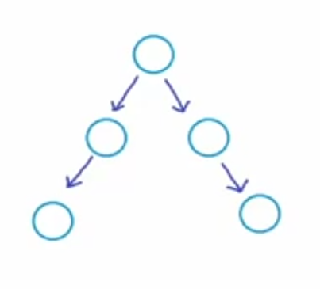
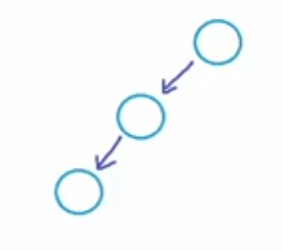
All of these are Binary Trees.

Slide 10
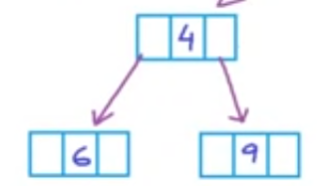
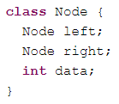
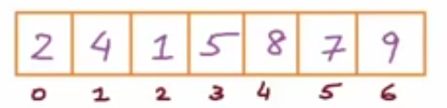
Implementation
We can implement Binary Trees using:
Dynamically created nodes
b) Arrays
For node at index i:
Left-child-index: 2i+1
Right-child-index: 2i+2

Slide 11
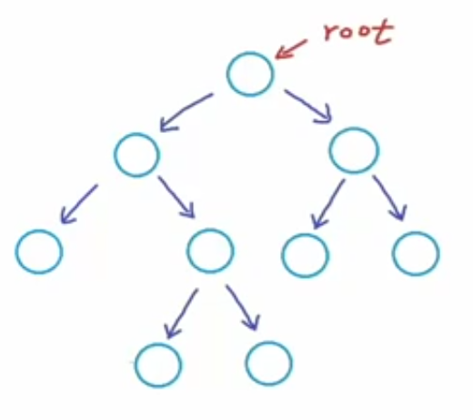
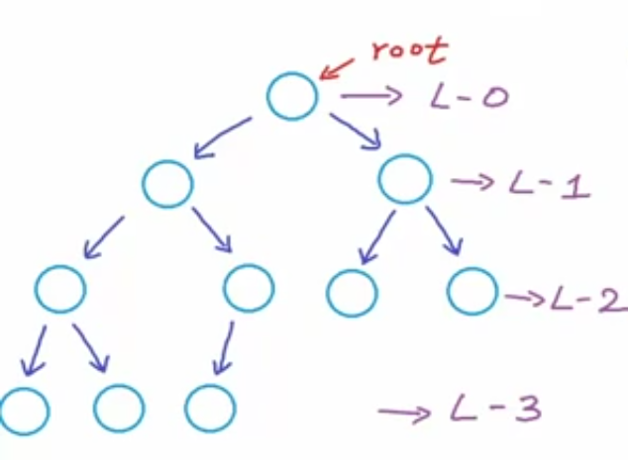
Types of Binary trees
Proper Binary Tree: Each node can have either 2 or no children.
Complete Binary Tree: All levels, possibly except the last are completely filled and all nodes are as left as possible.

Slide 12
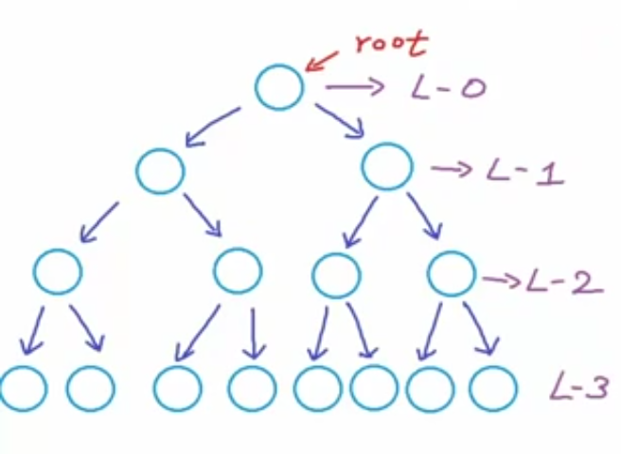
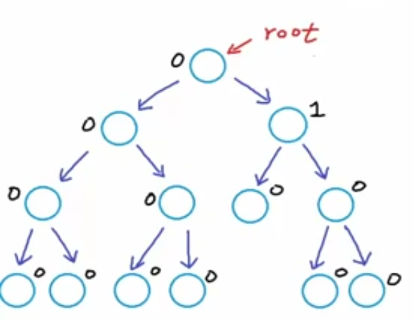
Types of Binary trees
Perfect Binary Tree: If all the levels are completely filled.
Balanced Binary Tree: Difference between the height of left and right subtree for every node is not more than k (mostly k=1).

Slide 13
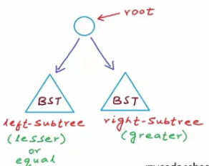
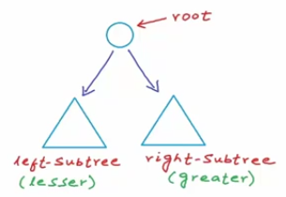
Binary Search Tree
A binary tree in which for each node, value of all the nodes in left subtree is lesser(or equal) and value of all the nodes in right subtree Is greater than the value of that node

Slide 14
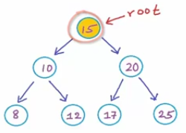
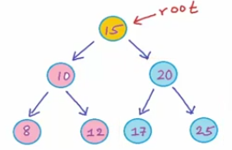
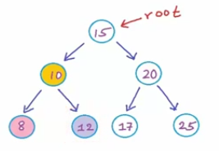
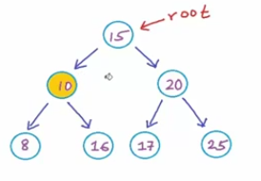
Which of these are BST’s?
1.
2.
No, Not a BST

Slide 15
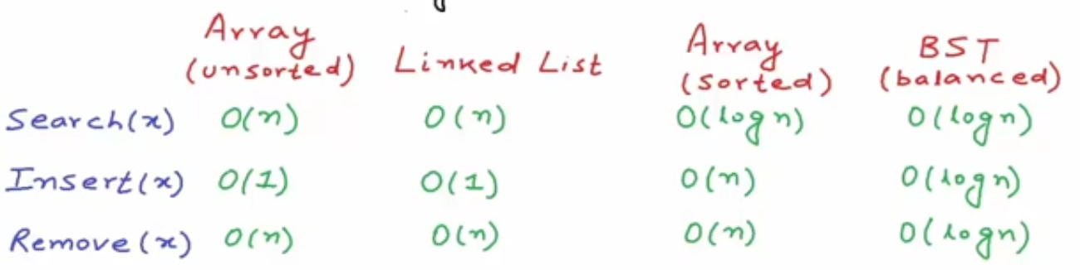
Comparison
What operations do we require for a modifiable collection:
Search(x)
Insert(x)
Remove(x)
What Data Structure can we use?

Slide 16
Traversals BFS
DFS – Preorder (VLR), Inorder(LVR), Postorder(LRV)
Insertion
Deletion

